Slide 1
Codominance

Slide 2
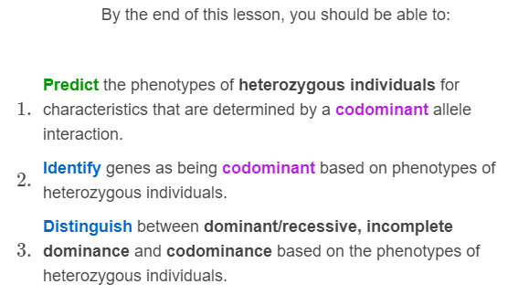

Slide 3
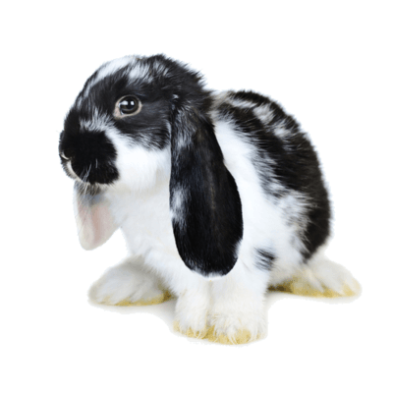
In codominance, there are no dominant or recessive alleles.
In heterozygous individuals, the phenotypes coded for by each allele coexist side by side. When dealing with colour, this often results in spots!

Slide 4
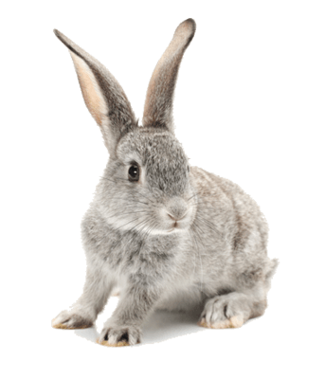
Codominance is different from incomplete dominance because the two phenotypes do not blend together.
Remember, in incomplete dominance a new intermediate phenotype is produced. This intermediate phenotype is halfway between the traits coded for by the two alleles. For example a rabbit with one allele for black fur and one allele for white fur will have grey fur.

Slide 5
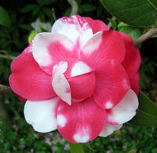
One example of codominance occurs in the flower colour of camellias.
One allele codes for red flowers and one for white. Flowers from heterozygous individuals have a combination of red and white spots.
If these alleles displayed incomplete dominance, the heterozygous individuals would have pink flowers.

Slide 6
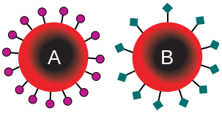
In humans, blood type is another example of codominance.
Your blood type is controlled by a gene with a couple of different alleles. These alleles code for different proteins to be placed on the outside of your red blood cells.
One allele codes for A-type proteins and another codes for B-type proteins.

Slide 7
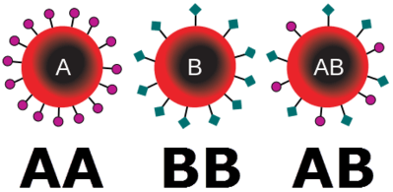
A-type and B-type alleles are codominant.
If a human has two alleles coding for A-type proteins, then they have the A blood type. Similarly, if they have two alleles coding for B-type proteins, then they have the B blood type.
If they have one allele coding for A-type proteins and one coding for B-type proteins, then their red blood cells have both A-type and B-type proteins. This produces the blood type AB.

Slide 8
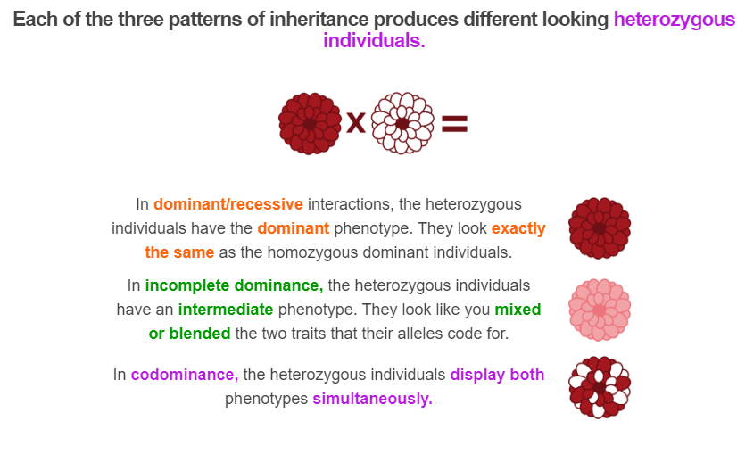

Slide 9
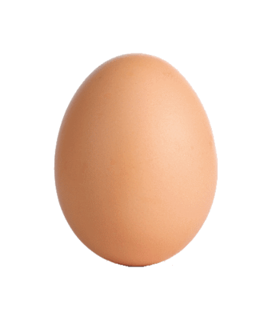
It is important to practice identifying examples of codominance.
Have a go at this practice question!
One homozygous bird lays eggs with blue spots. Another homozygous bird lays eggs with red spots.
Heterozygous individuals lay eggs with blue and red spots.

Slide 10
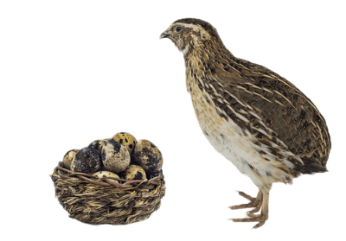
Yes! This is an example of codominance!
We know this because both traits coexist side by side. The heterozygous individuals have both red and blue spots on their eggs.
If this were incomplete dominance, then the spots would be purple or some other intermediate colour.

Slide 11
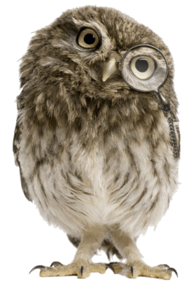
Here is another practice question:
If a homozygous curly-feathered bird is crossed with a homozygous straight-feathered bird, they produce heterozygous wavy-feathered offspring.
Wavy feathers are half way between curly and straight.

Slide 12
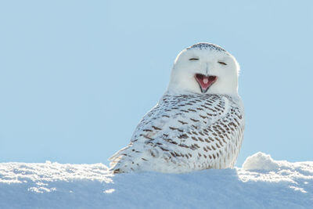
No! Instead, the shape of the feathers is an example of incomplete dominance.
This is evident as the wavy trait is halfway between the curly and the straight. It is a new, intermediate phenotype.
If the shape of the feathers was being controlled by a codominant allele interaction, then the heterozygous offspring would have some curly feathers and some straight feathers.

